Slide 1
SOUTH-WEST HEADS OF SERVICE SUMMIT 2019
In Collaboration With
DEVELOPMENT AGENDA OF WESTERN NIGERIA (DAWN)
18th – 20th November 2019
Venue:
Ado-Ekiti

Slide 2
SOUTH-WEST HEADS OF SERVICE SUMMIT 2019
Lessons from Office of Transformation, Strategy and
Delivery (OTSD)
Prof. Bolaji Aluko
SA/DG OTSD

Slide 3
OTSD – Office of Transformation, Strategy and Delivery
-Established 2011 Under Governor’s Office with DG
Fully Operational with EXCO Mandate (with Office Building) 2012
- Made a Bureau with ES and placed under HOS 2015
-Restored into an Office with DG under Governor 2018
Conceived as
-Part Think-Tank-Group
- Part Ombudsman Office
-Part Inspector-General Office
- Facilitator of Interactions Between MDAs
- Monitor and Evaluator of MDAs for Service Delivery

Slide 4
Reform Coordinating Offices (Offices of “Transformation”)
in the South-West
Lagos: OTCI - Office of Transformation, Creativity and Innovation)
Ogun: PSTO - Public Service Transformation Office
Ekiti: OTSD - Office of Transformation, Strategy and Delivery
Ondo: ??
Osun: ??
Oyo: ??

Slide 5
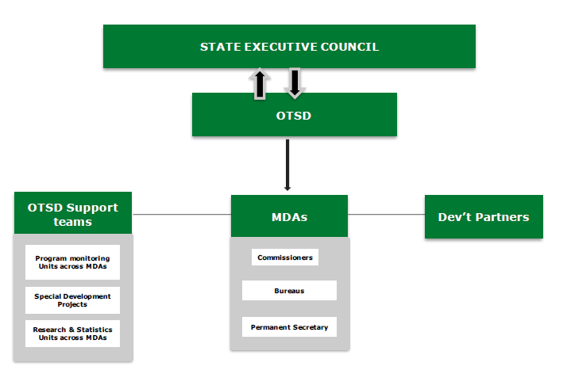

Slide 7
OTSD – Office of Transformation, Strategy and Delivery
One SA and Two SSAs
Interactions with Various Ministries
Vision, Mission and Mandate Review – by DFiD/DAWN
Choice and Inauguration of Focal Persons
Request through Focal Persons of Vision, Mission, Mandate
and Service Charter of Each of their MDAs
Grouping of MDAs into Five Clusters
\

Slide 8
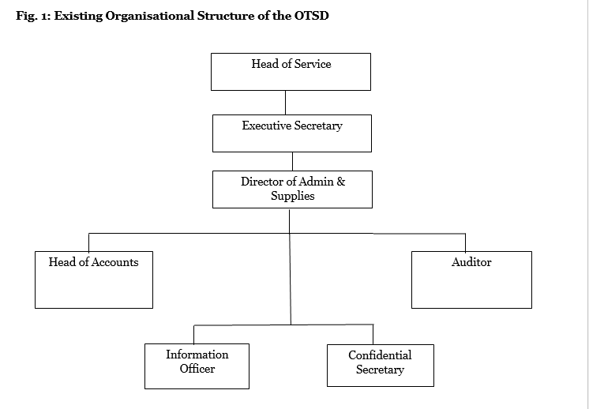

Slide 9
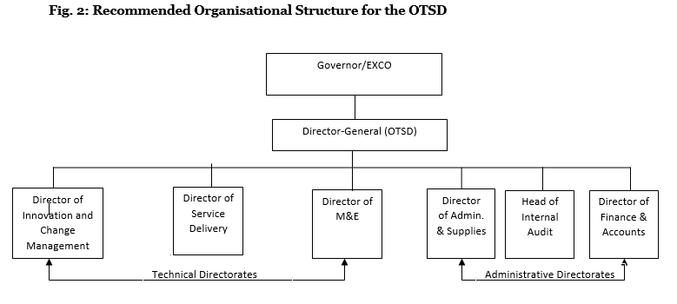

Slide 10
SOUTH-WEST HEADS OF SERVICE SUMMIT 2019
Results Delivery

Slide 11
A GUIDING OPERATING MAXIM:
All Government Work is about
Service Delivery to Citizens

Slide 12
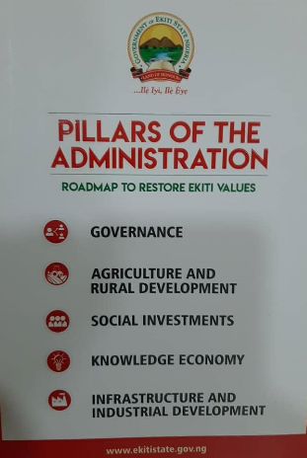

Slide 13
JKF 2.0 (2018 - 2022)
Five Pillars (GASKI/GISKA) of
Fayemi 2.0 Administration
1. Governance
1a. Streamlined Efficient and Effective Governance Structure
1b. Open, Accountable and Inclusive Governance
1c. Focused Approach to Measure and Enhance Productivity and Prosperity in the State

Slide 14
Agriculture and Rural Development
2a. Agribusiness
2b. Sustainable and commercial value chain approach
2c. Inclusion of rural regions in productivity and prosperity
Social Investments
3a. Instituting safety nets to the vulnerable (Social security scheme, etc.)
3b. Delivering qualitative universal healthcare

Slide 15
Knowledge Economy
4a. Knowledge as Business
4b. Special attention to certain key fields (eg IT, Biotechnology, Creative Arts, etc.) for promotion of sustainable development
4c. Ekiti Knowledge Zone EKZ establishment
4d. Establishment of Critical linkages
4e. Delivering qualitative and accessible education

Slide 16
5. Infrastructure and Industrial Development
5a. Integrated Transportation Network (Roads, Rail, Airport), Energy, Water, Housing
5b. Community based projects
5c. Enabling Environment for Light and Heavy Manufacturing Industries
5d. Tourism and Cultural Assets5e. Security network

Slide 17
ANOTHER GUIDING OPERATING MAXIM:
Service Delivery is Through
Ministries, Departments and Agencies (MDAs)

Slide 18
[Extracted from Briefing Pack for State Commissioners]

Slide 22
SOUTH WEST HEADS OF SERVICE SUMMIT 2019
Performance Evaluation

Slide 23
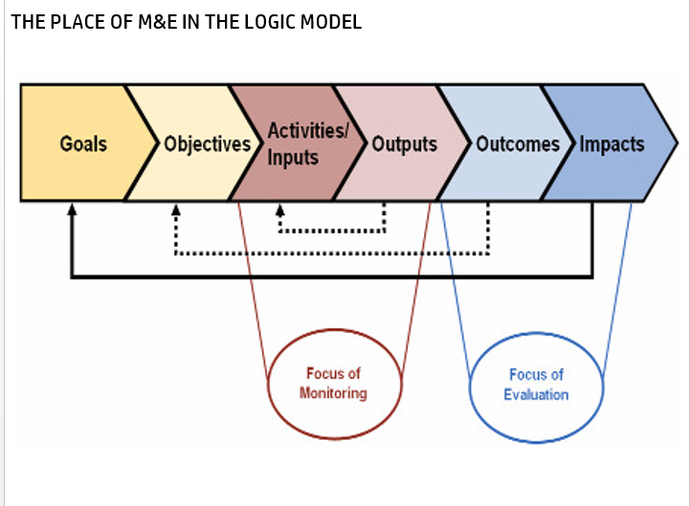

Slide 24
SOUTH-WEST HEADS OF SERVICE SUMMIT 2019
Results Delivery
1. Communication Within MDA
2. Initiation of Tasks
3. Progress of Tasks
4. Completion of Tasks
5. Public Awareness of Tasks Implementation
Impact of Tasks Completion
Executive Performance Agreements

Slide 25
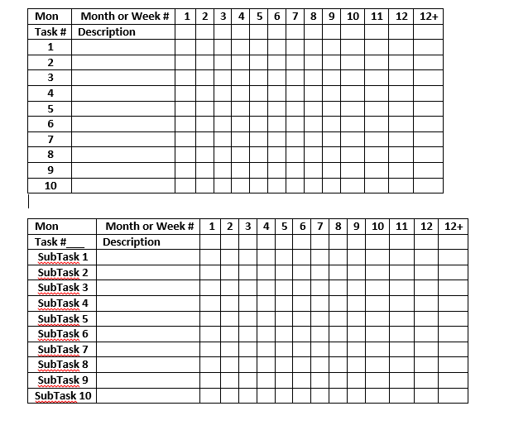
GANT CHART

Slide 27
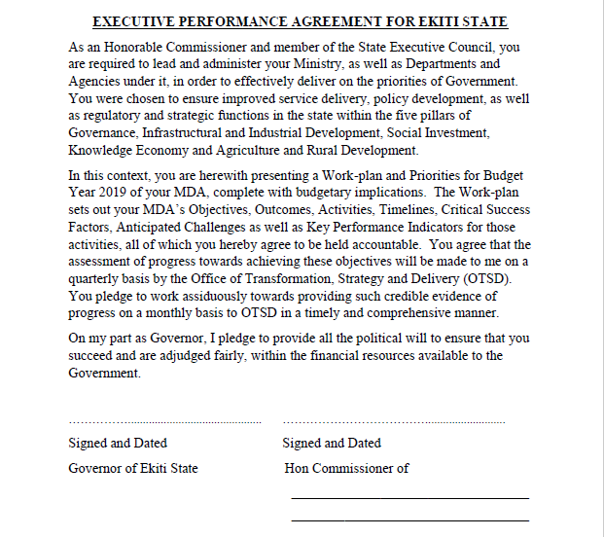

Slide 28
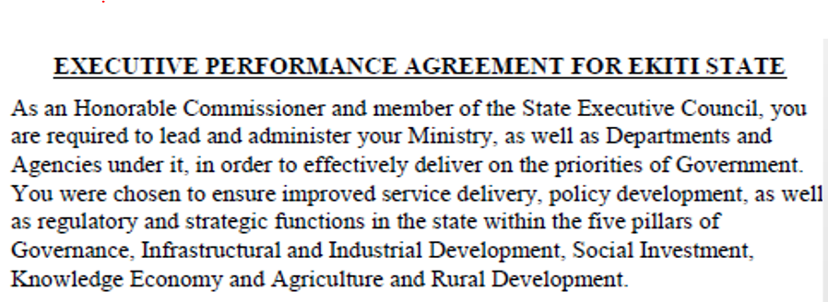

Slide 29
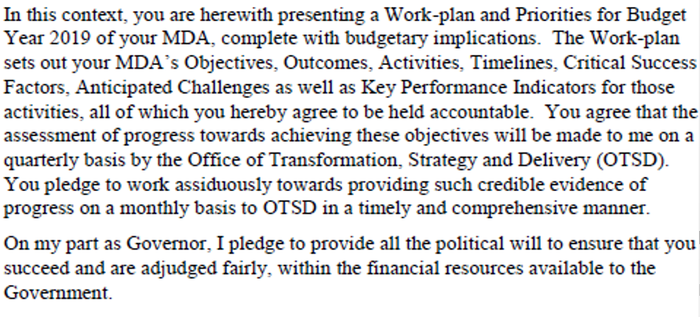

Slide 30
SOUTH-WEST HEADS OF SERVICE SUMMIT 2019
Summary/Conclusion
A Reform Coordinating Office is Essential
For Coordinating, Monitoring and Evaluating
Service Delivery in Government

Slide 31
I THANK YOU
&
WELCOME QUESTIONS

